Slide 1
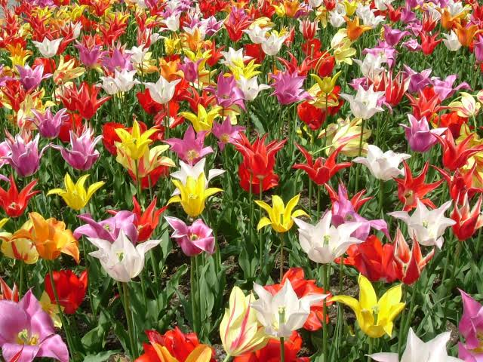
Bulbous
Plants

Slide 2
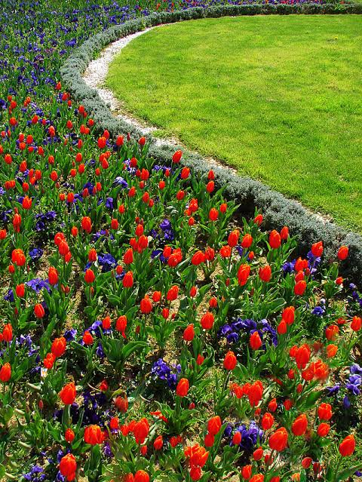
Introduction
Ornamental Bulbous Plants, often Called Ornamental Bulbs Or Ornamental Geophytes In Horticulture.
Most Of The Bulbous Plants Die Down To The Ground For Some Period Of The Year.
The Bulbous Part Of The Plant Will Store The Food Required By Them To Restart In The Growing Season.

Slide 3
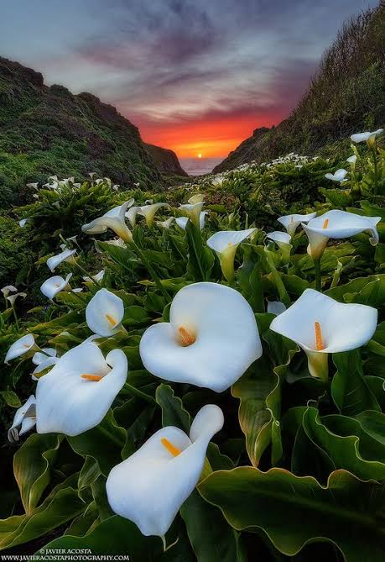
Advantages Of Bulbous Plants
The Bulbous Plants Enhance The Aesthetic Beauty Of The Human Surroundings.
They Can Be Grown As Ground Cover In The Shrubberies And Arboreta.
The Bulbous Plants With Fragrant Flowers Fill The Air With Enticing Aroma.
Some Bulbous Plants Purify The Indoor Environment By Absorbing Pollutants.
Used To Decorate The Indoor As Well As Outdoors.

Slide 4
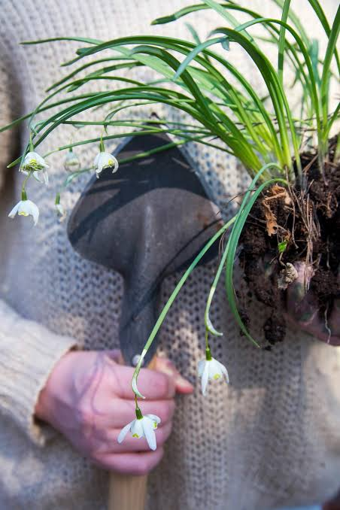
Propagation Of Bulbous Plants
Through Bulbs.
Corms.
Tubers.
Rhizomes.
Seeds.
Now Some Of The Bulbous Ornamentals Are Also Multiplied Through Plant Tissue Culture Techniques.

Slide 5
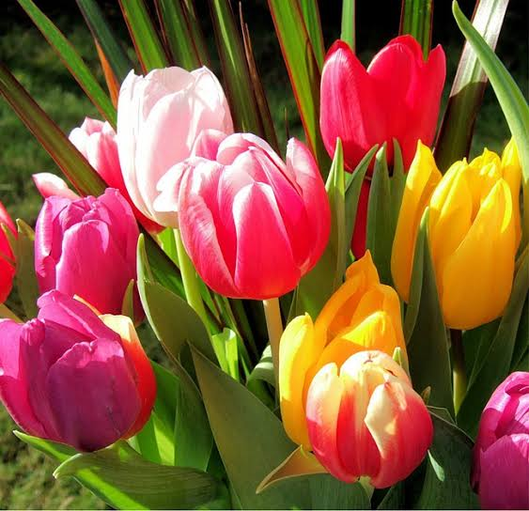
Examples Of BulbousPlants

Slide 6
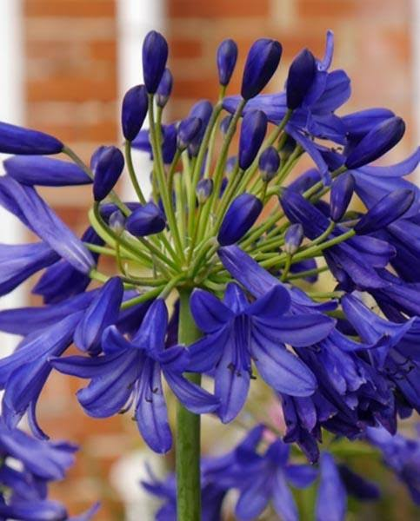
African Lily
Botanical Name : Agapanthus Africanus
Family : Amaryllidaceae
Origin : Africa
Flower Colour : Pale-blue, white
Flowering Season : July-September
Uses-as A Decoration
To Ensure An Easy Delivery And A Healthy Child

Slide 7
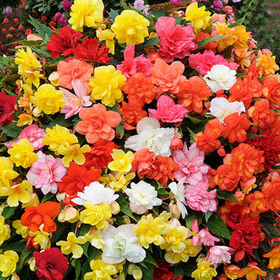
Begonia
Botanical Name : Begonia
Family : Begoniaceae
Origin : Tropical Subtropical Countries Except Australia
Flower Colour : Red, orange, pink, yellow, white
Flowering Season : June-November
Uses-to Form A Injection Of Vitamin B12
For Releasing Energy From Food
For Vitamin B11

Slide 8
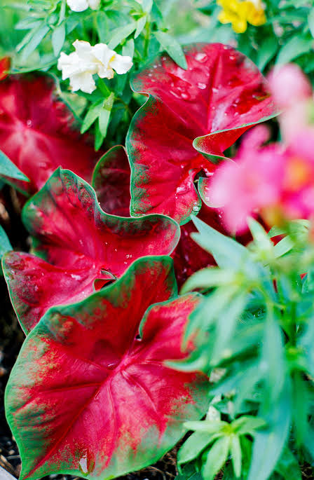
Caladium
Botanical Name : Caladium Bicolor
Family : Araceae
Origin : Tropical America
Uses-treatment Of Sexual Disorders In Mans

Slide 9
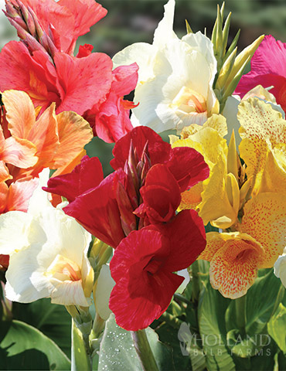
Canna
Botanical Name : Canna Indica
Family : Cannaceae
Origin : Tropical America
Flower Colour : Orange, red, pink, yellow, scarlet
Flowering Season : Through Out The Year
Uses-rich In Starch
Producing The Fermented Alcohol
For Obtaining Dye

Slide 10
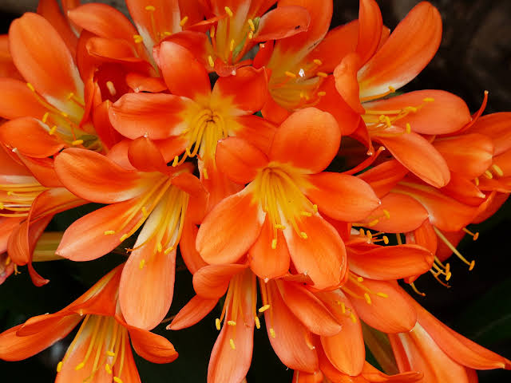
Clivia Lily
Botanical Name : Clivia Miniata
Family : Amaryllidaceae
Origin : Africa
Colour : Scarlet, Orange-yellow
Flowering Season : Summer
Uses-treating Pain
Fever
Muscle Stimulation

Slide 11
Crinum
Botanical Name : Crinum Latifolium
Family : Amaryllidaceae
Origin : Tropical Asia And Africa Including India
Colour : White, reddish
Flowering Season : June-November
Uses-cure Ailments And Diseases

Slide 12
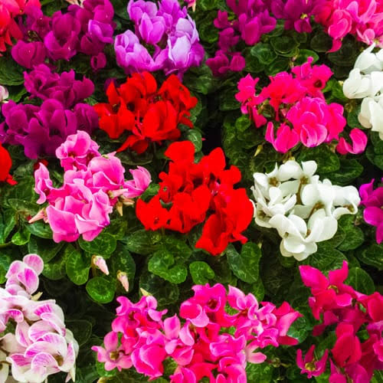
Cyclamen
Botanical Name : Cyclamen Persicum
Family : Primulaceae
Origin : Mediterranean
Colour : Pink, purple, red, white
Flower Season : Autumn To Spring
Uses-for Menstral Disorder In Women

Slide 13
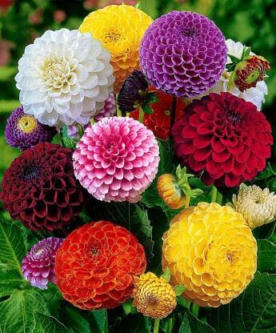
Dahlia
Botanical Name : Dahlia Hybrids
Family : Asteraceae
Origin : Mexico
Flower Colour : Pink, red, yellow, white
Hight : 20-150 Cm
Uses-treating Rashes And Cracks In Skin
Rich in Antibiotic Compounds

Slide 14
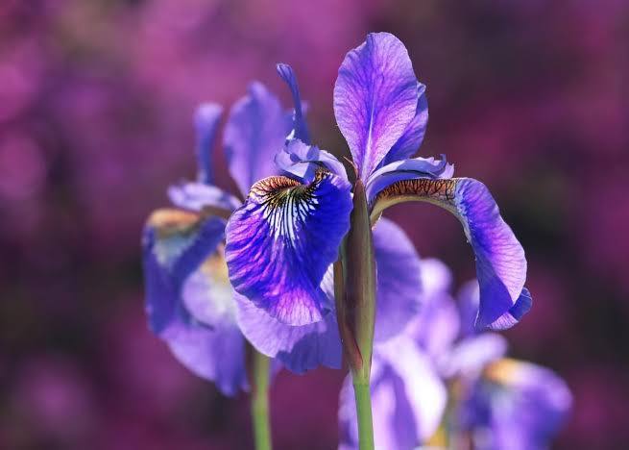
Irises
Botanical Name : Irises Spp.
Family : Iridaceae
Origin : South Asia
Flower Colour : Purplish
Flower Season : Early Summer
Uses-as Sedative Medicines
For Giving Colour To Food

Slide 15
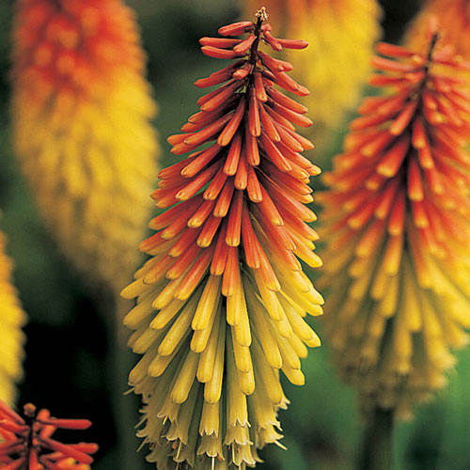
Torch Lily
Botanical Name : Kniphofia Uvaria
Family : Asphodelaceae
Origin : South Africa
Flower Colour : Cora-red
Flower Season : Rainy
Uses-treating Of Ulcers, open Wounds, cholera, kidney Problems, snake Bite

Slide 16
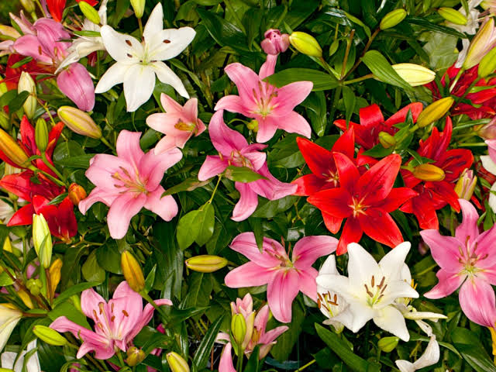
Lilies
Botanical Name : Lilium
Family : Liliaceae
Origin : Japan, China, Korea, U.S.A.
Flower Colour : Red, orange, yellow, white
Flower Season : Throughout The Year
Uses- Used For Heart Problems

Slide 17
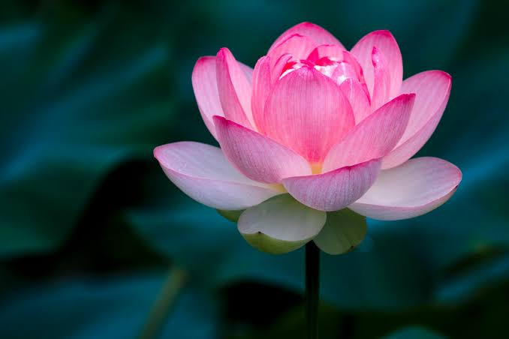
Lotus
Botanical Name : Nelumbo Nucifera
Family : Nymphaeaceae
Origin : Asia Including India
Flower Colour : Pink
Flower Season : July-October
Uses- For Bleeding Cough, fever, liver, stomach Problems

Slide 18
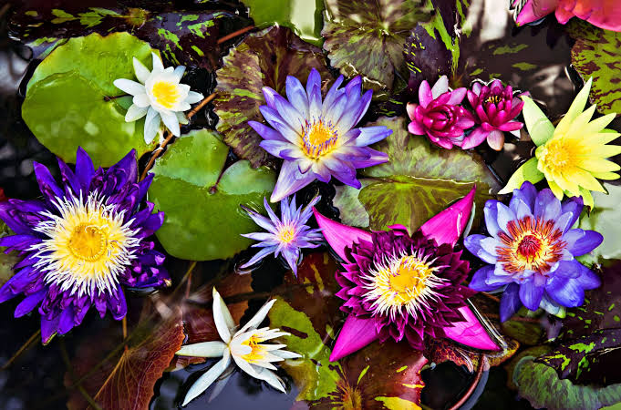
Water Lilies
Botanical Name : Nymphaea
Family : Nymphaeaceae
Origin : Europe, south Africa, Australia
Flower Colour : Blue, red, pink, yellow, lemon
Flower Season : June-October
Uses- Treat Ongoing Diarrhea

Slide 19
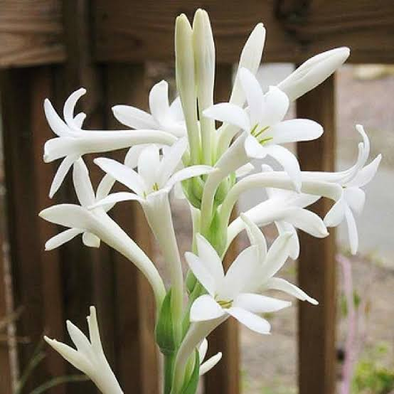
Mexican Tuberose
Botanical Name : Polianthes Tuberosa
Family : Agavaceae
Origin : Mexico
Flower Colour : White
Flower Season : Summer, rainy Season
Uses- Making Artistic Garlands
Extraction Of Oil.

Slide 20
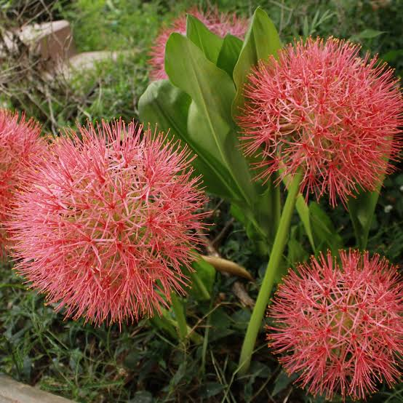
Blood Lily
Botanical Name : Scadoxus Multiflorus
Family : Amaryllidaceae
Origin : Tropical Africa
Flower Colour : Red, pinkish-red
Flower Season : Summer
Uses- Treat Dropsy, poorly Healing Wound

Slide 21
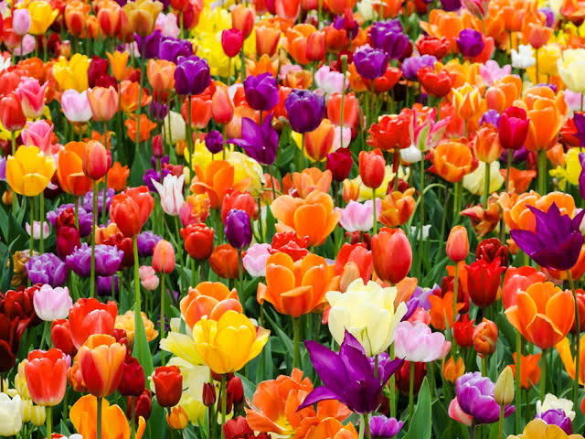
Tulip
Botanical Name : Tulipa
Family : Liliaceae
Origin : Europe, Africa
Flower Colour : Red, pink, orange, yellow, white
Flower Season : Summer
Uses- Dry Sensitive Skin
Making Perfumes

Slide 22
SOURCES:
Book on Gardening and Floriculture, by S. Dinesh & Co.
Internet recourses for plants images

Slide 23
Thank-you

